Slide 1
1-paper

Slide 2
Llms conventional language models
Training and inference of LLMs require considerable computational resources
Progress in LLMs has been achieved by improving pre-training techniques and expanding training datasets
Pre-trained language models (PLMs) have become prevalent since the late 2010s
PLMs learn universal language representations from extensive data
The advancement of LLMs depends on the availability of pre-trained datasets

Slide 3
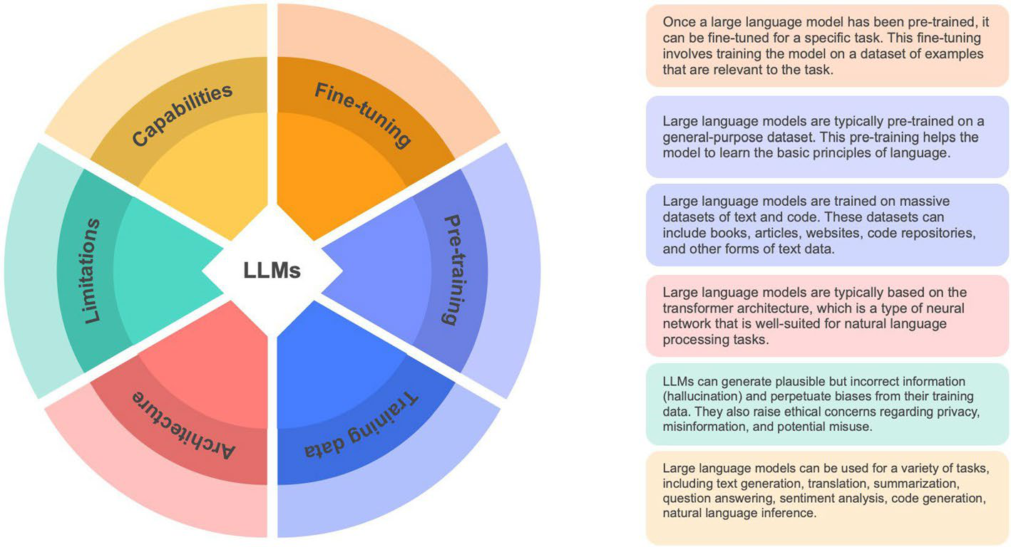
Llms conventional language models - Image 1

Slide 4
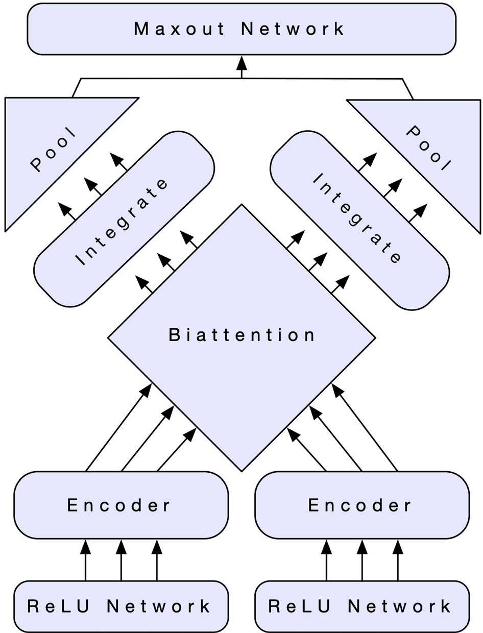
Llms conventional language models - Image 2

Slide 5
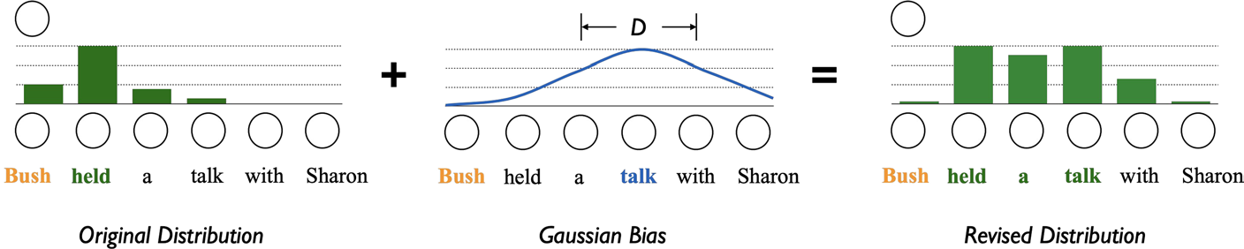
Llms conventional language models - Image 3

Slide 6
Language model employs deep
The document analyzes challenges related to language models
Tokenization techniques like Byte-Pair Encoding (BPE) and Unigram Language Model (ULM) are used to create vocabularies for language models
Tokenization involves breaking text into tokens, which are fundamental components for language models
The research focuses on established methodologies and may not include recent developments in language models

Slide 7
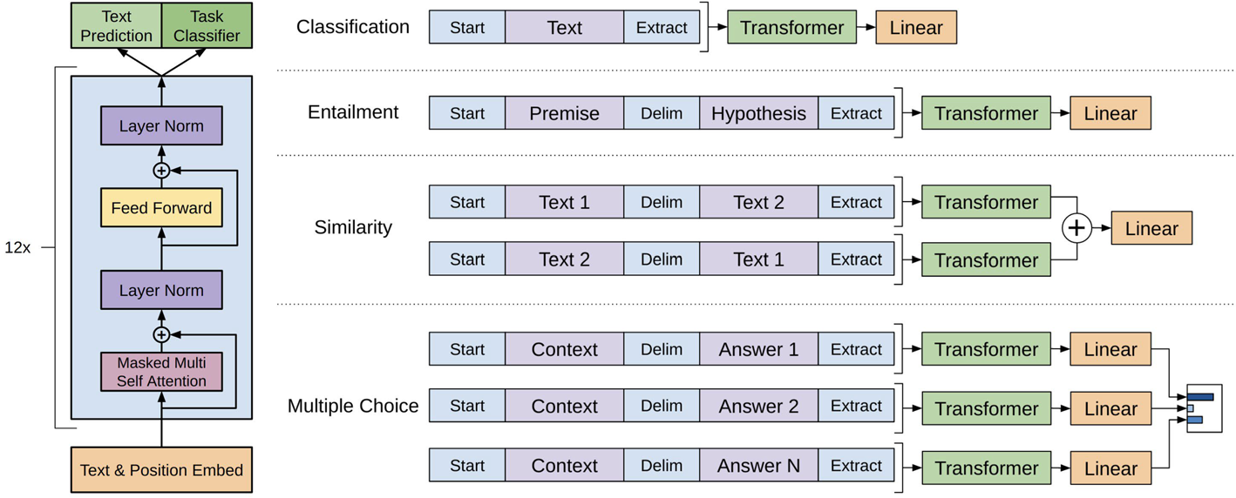
Language model employs deep - Image 1

Slide 8
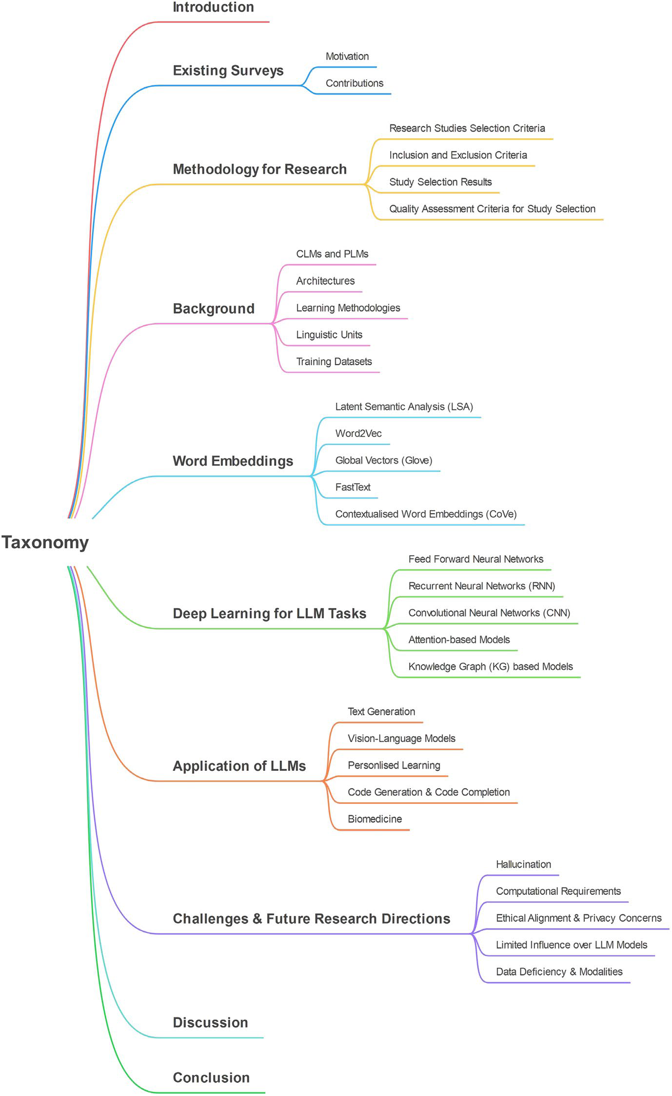
Language model employs deep - Image 2

Slide 9
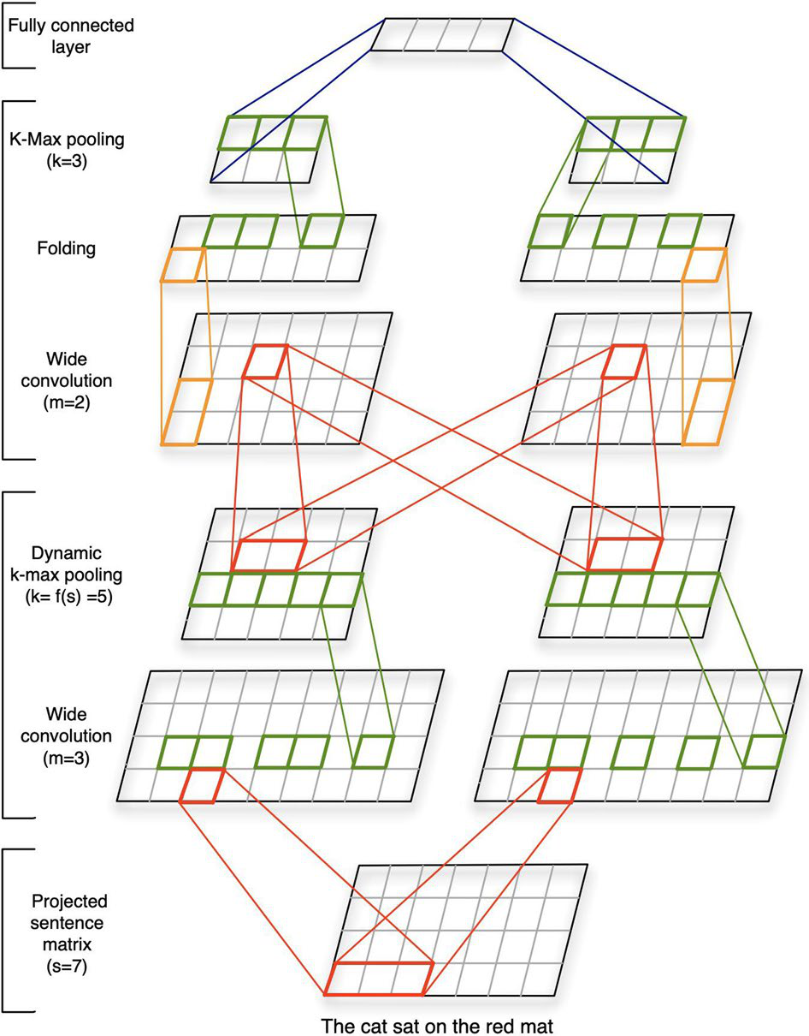
Language model employs deep - Image 3

Slide 10
Nlp tasks llms
LLMs can improve their functionalities
LLMs are complex and their architecture is inaccessible, which limits their benefit from certain methods
PLMs can generate text independently
Text generation is a key application of LMs
Reformulating tasks as text generation can help apply LLMs to address them efficiently

Slide 11
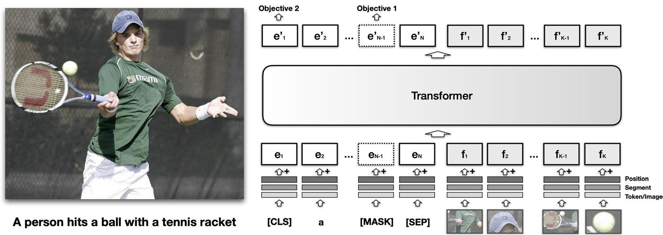
Nlp tasks llms - Image 1

Slide 12
Provided large language models
The document section examines Transformer-based language models
Language models require significant computational resources for training and inference
Vocabulary construction often uses techniques like Byte-Pair Encoding (BPE) or Unigram Language Model (ULM)
Fine-tuning with custom datasets and objectives is used for specific applications
Language models are trained on extensive textual datasets and can perform various language processing tasks

Slide 13
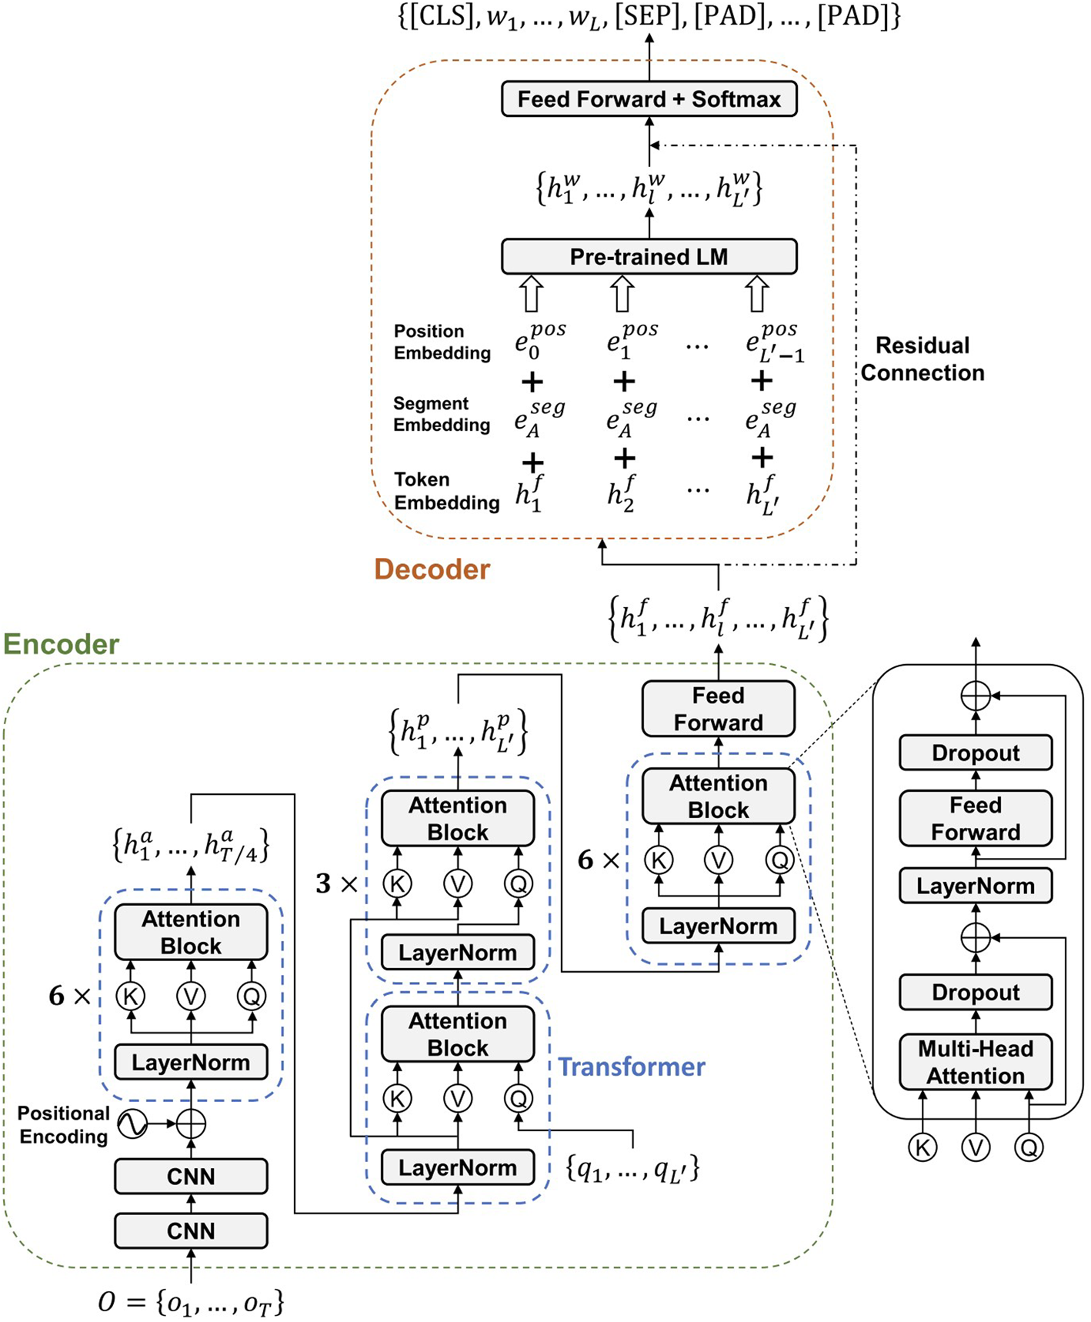
Provided large language models - Image 1

Slide 14
2018 large language models
Large Language Models (LLMs) are pushing boundaries, but issues exist regarding their implementation
Concerns include improper use, unethical implementation, and compromised integrity
Research primarily focuses on established methodologies and might not include recent developments
Transformer-based language models are examined
Further development is needed for LLMs to reach their full potential, alongside ethical guideline establishment

Slide 15
Improves large language models
Large Language Models (LLMs) face challenges including improper use, unethical implementation, and compromised integrity
LLMs can generate text that seems plausible but contains incorrect or inappropriate information
LLMs are often fine-tuned with specific datasets and objectives for their intended applications
The research may focus on established methodologies, potentially overlooking recent developments

Slide 16
Large language models
Training and inference of Large Language Models (LLMs) require significant computational resources
The document examines Transformer-based language models
Tokenization techniques like Byte-Pair Encoding (BPE) and Unigram Language Model (ULM) are used for vocabulary construction
Various tokenization strategies have unique advantages and disadvantages
The document touches on language models used for code generation

Slide 17
Nlp ai models
The text provides an overview of Large Language Models (LLMs) within the context of Natural Language Processing (NLP)
It highlights the progression of NLP and AI models, including the initial challenges and advancements
The text mentions the use of neural networks and fine-tuning in models like BERT for NLP tasks
The importance of developing new methodologies is emphasized for future advancements in NLP
The text touches upon the use of deep learning algorithms and the significance of generative language models

Slide 18
2017 large language models
The document examines Transformer-based language models (LLMs)
Tokenization strategies are discussed in relation to LLMs, acknowledging their benefits and constraints
The research primarily focuses on established methodologies and may not cover recent advancements in language models
LLMs have potential ethical concerns, including improper use and compromised integrity
The development of LLMs requires significant computational resources

Slide 19
2022 improving language models
The document analyzes language models, focusing on challenges and limitations
Language models are trained on extensive textual datasets and used for various language processing tasks
Tokenization, the process of breaking down text into tokens, is a fundamental component of language models
The research may focus on established methodologies and might not cover recent advancements
Addressing limitations and ethical issues in natural language processing requires significant effort

Slide 20
2019 large language models
The document discusses challenges related to large language models (LLMs)
Concerns about LLMs include improper use, unethical implementation, and compromised integrity
The research may focus on established methodologies, potentially overlooking recent developments in the rapidly evolving field of language models
Transformer-based language models and their architectures are examined
Further development of LLMs is needed, with the need to address issues such as the production of incorrect or inappropriate text

Slide 21
Llms various nlp tasks
NLP applications face obstacles due to language complexity and computational demands
LLMs can be applied to NLP tasks by reformulating them as text generation challenges
LLMs' architectures and parameter spaces are complex and inaccessible, limiting the use of some NLP methods
Training and inference of LLMs require substantial computational resources
LLMs can generate human-like language and have shown recent progress in NLP

Slide 22
Language models llms various
Training and inference of Large Language Models (LLMs) require significant computational resources
Progress in LLMs has been achieved through improved pre-training techniques and expanding the training data
Transformer-based language models are examined and summarized
LLMs' architecture and parameter space complexity limits the influence of certain methods
Visual Language Models (VLMs) draw inspiration from pre-trained models in computer vision (CV) and natural language processing (NLP)

Slide 23
Creating large language models
Tokenization strategies are important and have different benefits and constraints, influencing language modeling
The document examines Transformer-based language models (LLMs)
The document mentions potential issues with LLMs, including misuse, ethical concerns, and compromised integrity
A limitation of the research is that it might not include recent developments in the quickly evolving field of LLMs
Training and inference of large language models require significant computational resources

Slide 24
Language models llms
Training and inference of Large Language Models (LLMs) require significant computational resources
Transformer-based language models are examined
LLMs don't benefit from certain methods due to architectural complexity
There is limited influence over LLM models
LLMs are improving in discerning true statements

Slide 25
Language modeling mlm
The analysis focuses on challenges within the language model domain
The research primarily uses established methodologies
Vocabulary construction techniques like BPE and ULM are utilized
Sentence modeling provides insights into semantic meaning and aids software development
Tokenization is a crucial step in language models, involving the division of text into tokens

Slide 26
Llm technology evolving nlp
LLMs are a prominent area within NLP and are capable of generating human-like language
Understanding the capabilities and limitations of LLMs is crucial for maximizing their utility in NLP tasks
NLP faces obstacles due to the intricacies of language and computational demands
The document discusses challenges and limitations in existing LLM models
The current state of LLM technology and the evolving NLP landscape are key areas of focus

Slide 27
Large language models llms
Training and inference of Large Language Models (LLMs) require considerable computational resources
The document examines Transformer-based language models (LLMs)
LLMs' architecture complexity limits the influence of certain methods
Improvements in LLMs are achieved through pre-training techniques and expanded training data
The document discusses technical frameworks and surveys related to LLMs

Slide 28
Llms large language models
Training and inference of LLMs require considerable computational resources
The document discusses Large Language Models (LLMs) and their functionalities
LLMs are examined through the lens of Transformer-based language models and their architectures
Current language models (LMs) are utilized for specific tasks like code generation
LLMs may not benefit from certain methods due to their complex architecture and parameter space

Slide 29
Vey large language models
Training and inference of Large Language Models (LLMs) require significant computational resources
Transformer-based language models are examined and synopses are provided
Tokenization techniques like Byte-Pair Encoding (BPE) and Unigram Language Model (ULM) are used to build vocabularies
LLMs have advanced by improving pre-training methods and expanding training data
Training LLMs involves managing large datasets and optimizing model parameters, which can be computationally intensive

